Slide 1
The educator
Final ComPro Project

Slide 2
About our Project
Our project is coded in Python, because we saw that using Python would give us a lot of flexibility and freedom. We are making a project that helps kids learn basic vocabulary, times table, and the correlation between flags and their respective countries. We picked these three subjects because we feel as if these topics were the most necessary skills that children need to know.

Slide 3
About our project
We aim to help kids become more educated through teaching them the basic knowledge. This will help kids not only study better, they will become more educated in general. The problem addressed is this: when kids do not have a fundamental understanding of basic material, they cannot efficiently learn in school. Therefore, our project aims to make kids smarter through rote repetition.

Slide 4
The educator
Our name of our project is The Educator, because just like the name suggests, our app educates kids. It’s very generic because our app is generic; it’s aimed towards rote repetition for learning, not a fun alternative where kids get distracted from the true purpose.

Slide 5
Functionality
Some functions of our project are Vocabulary, Times Table, and Flag recognition. Kids can click on one of the subjects so that they can begin studying it.

Slide 6
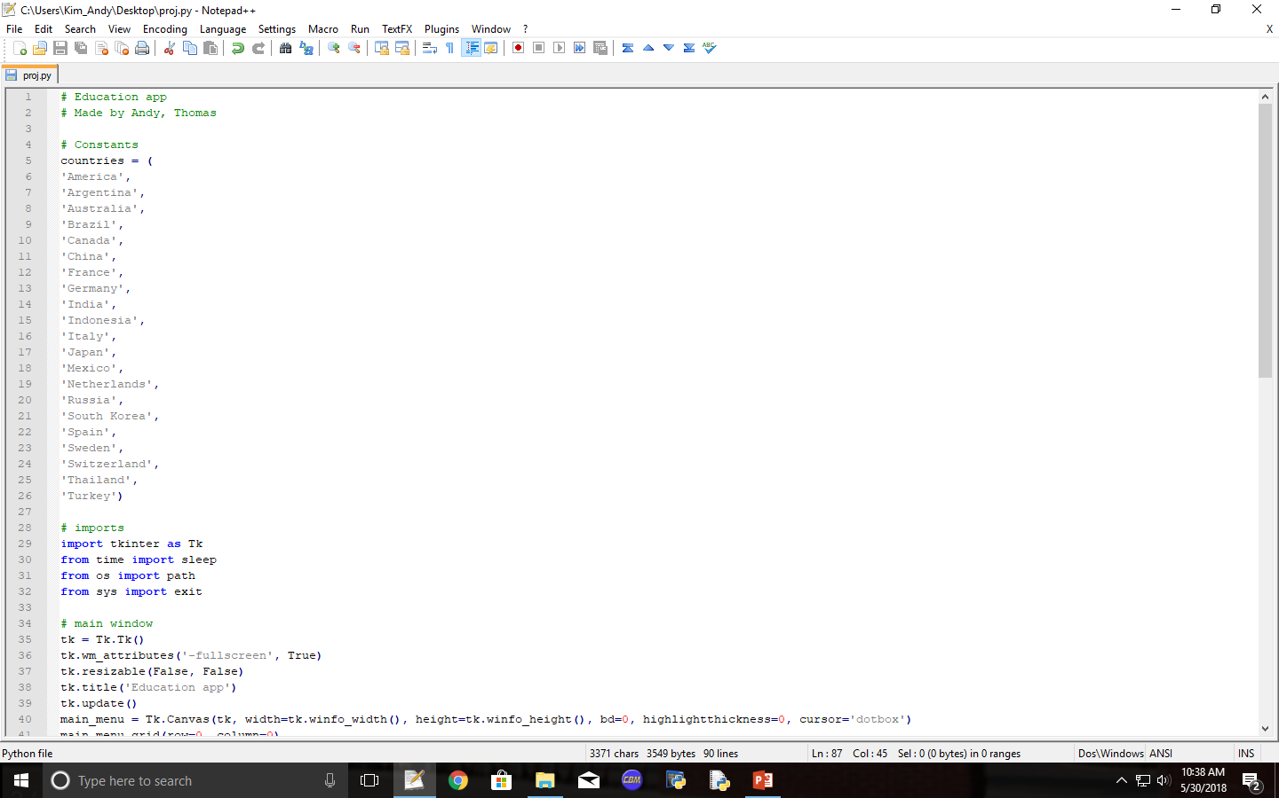

Slide 7
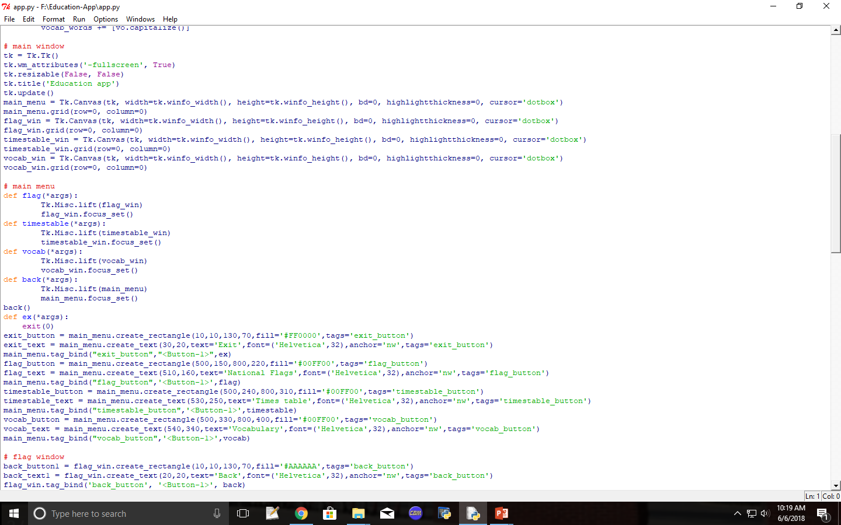

Slide 8
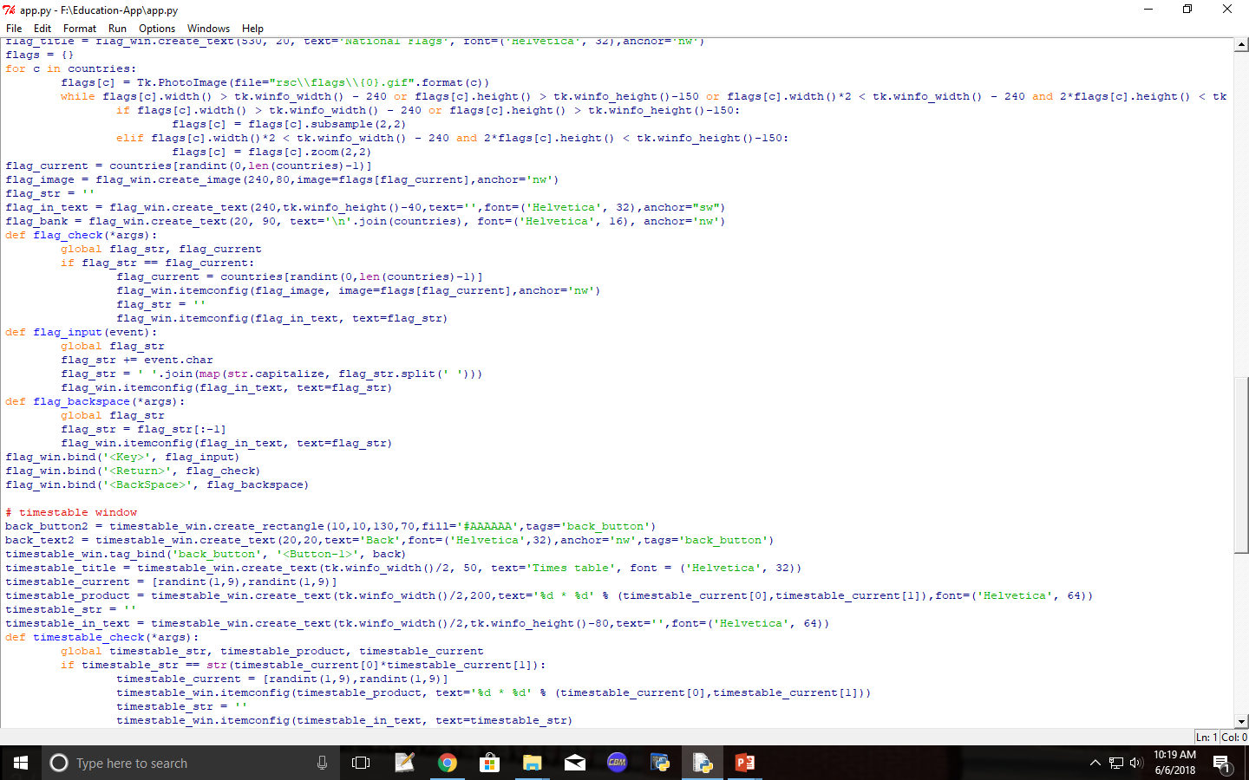

Slide 9
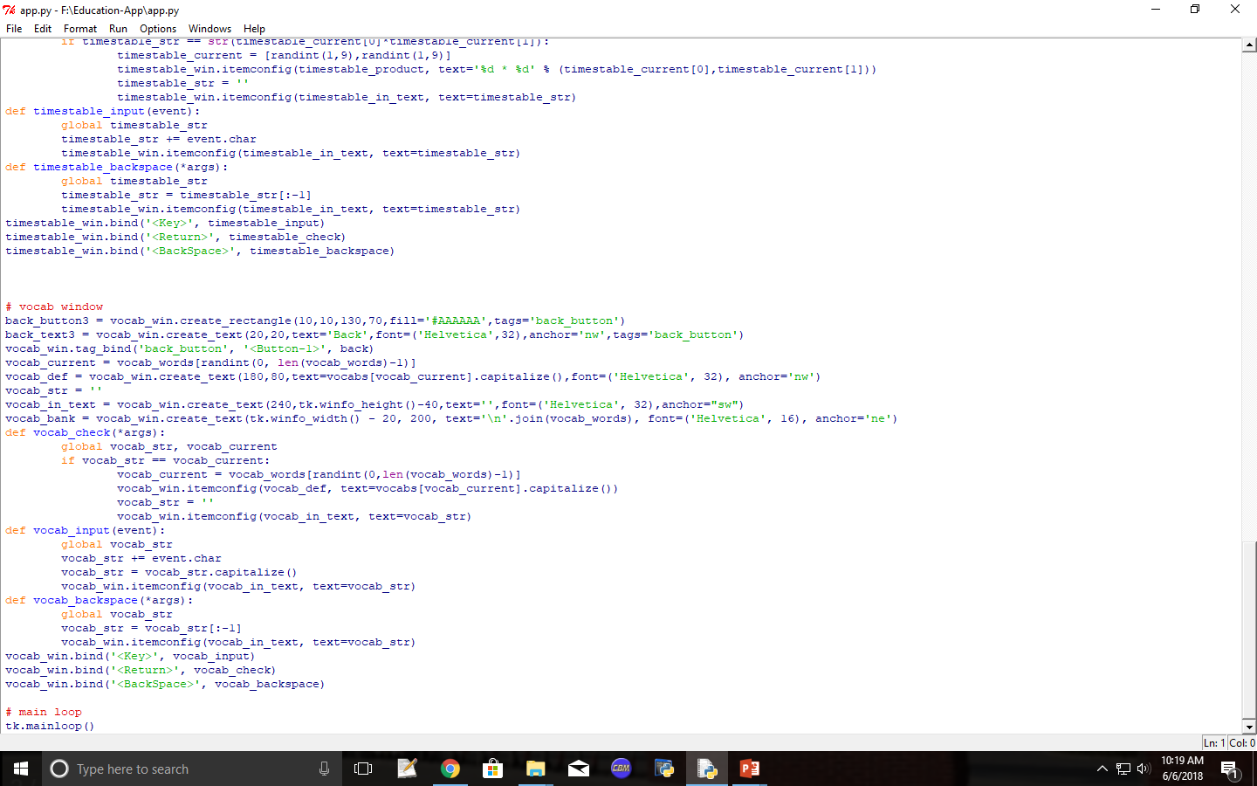

Slide 10
Explanation
Each window had to be separately coded, so the window for each topic were individually coded. The main menu held a separate code, along with the national flags, times table, and the vocabulary. Each button had individual functions that corresponded with what it was supposed to do. For example, when the national flag button was pressed, it would have to go to the national flags window rather than the times table window, and so on with the other buttons.

Slide 11
Backfeed
“I mean, it wasn’t bad. There could be improvements for every everything. Time, points, no unlimited guesses. Maybe instead of waiting for the thing to buzz, you can like … you can let it be wrong. Give the right answer and give the next question. you know what I am saying?” – Alex Marker
“It’s good. It’s fun. It’s educational. You guys have should add points.” –Jhihyang Wu

Slide 12
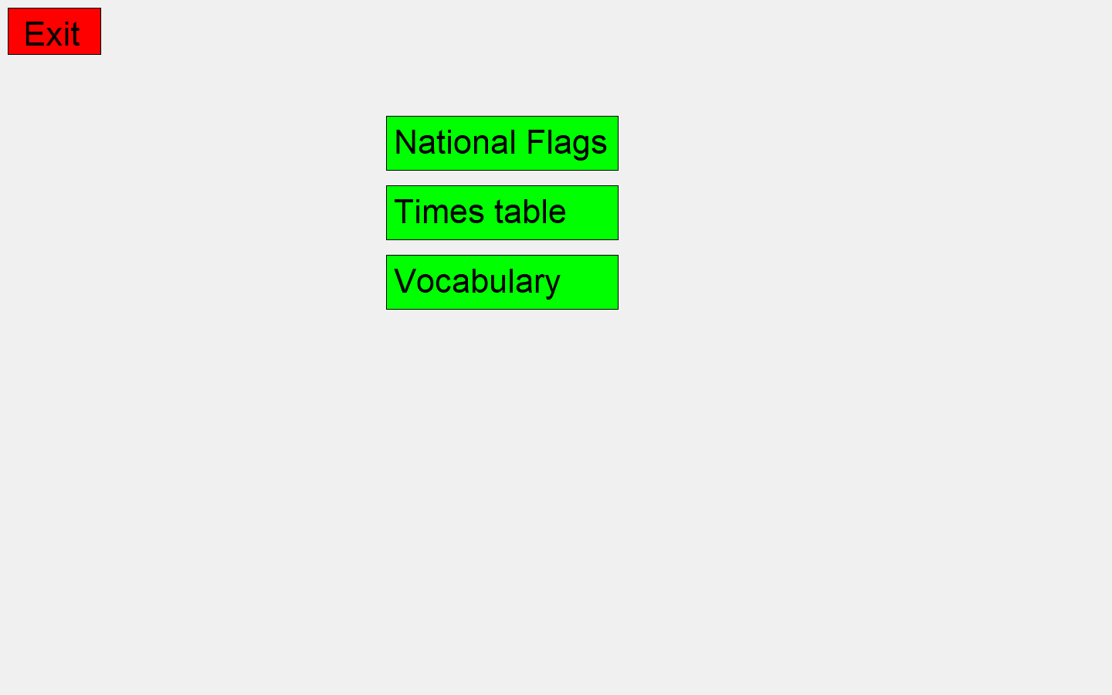
Click here for National Flags test
Click here to exit
Click here for the times table test
Click here for the vocabulary test

Slide 13
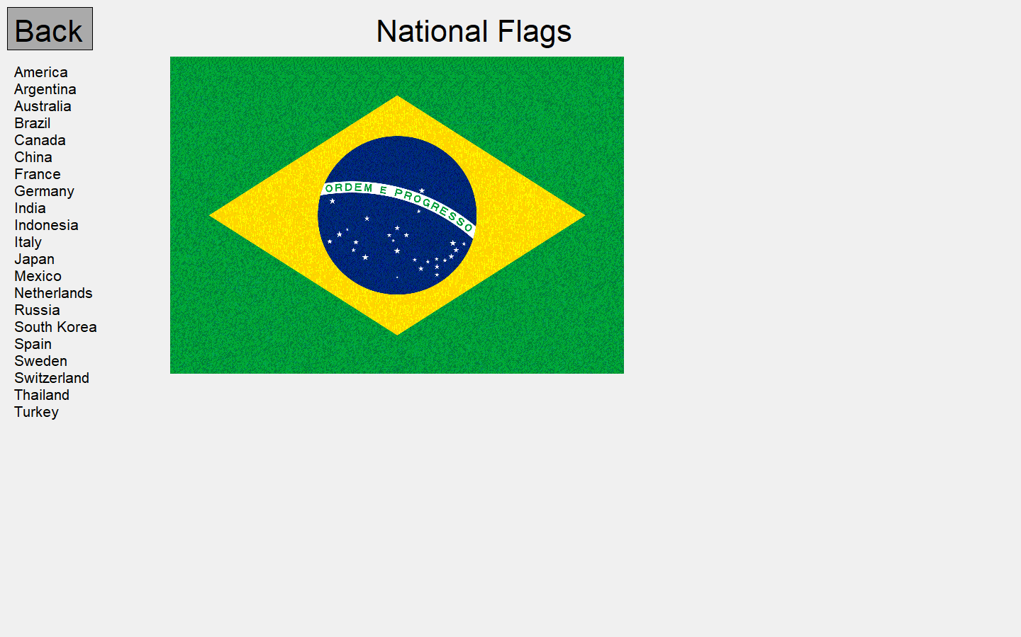
If you type the wrong name, it won’t do anything if you press enter. You need to re-type it
Begin typing the country’s flag name and it will show up here

Slide 14
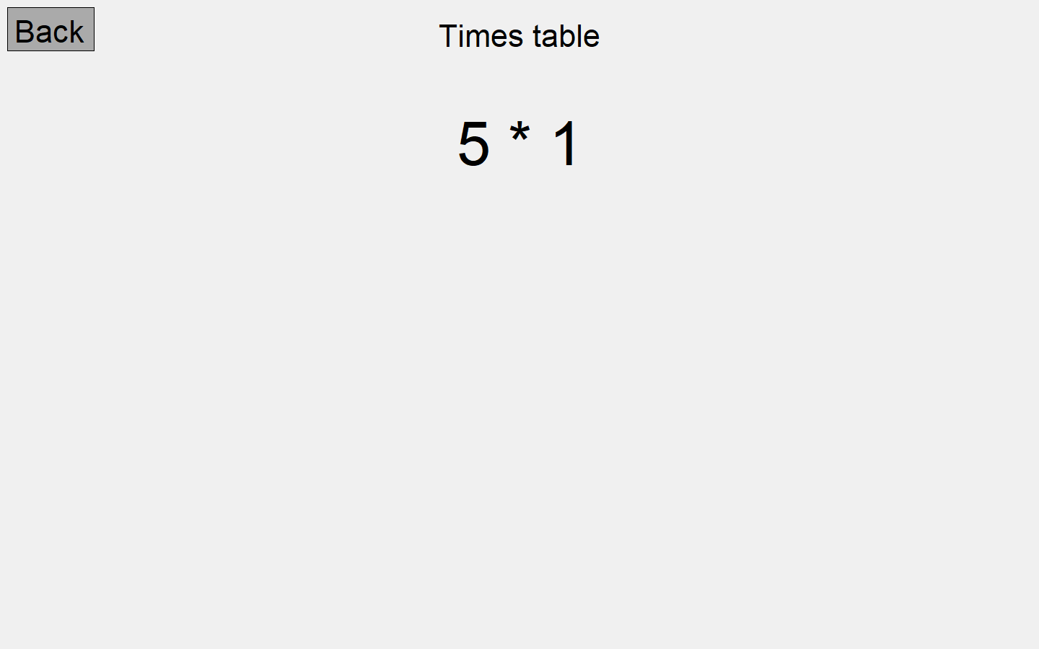

Slide 15
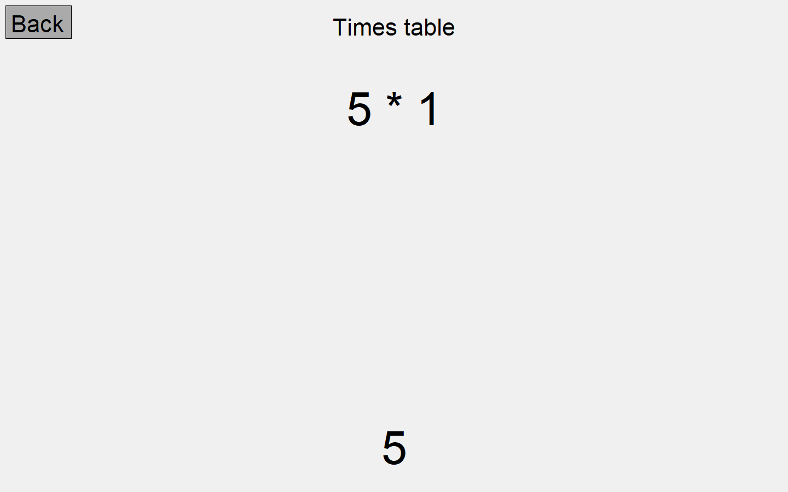

Slide 16
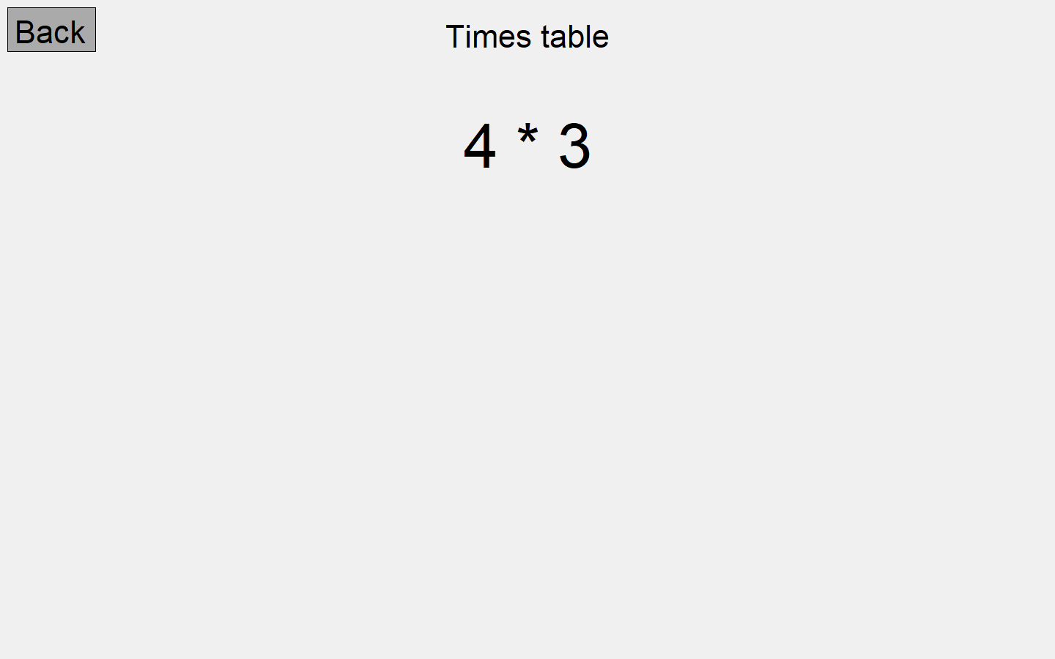

Slide 17
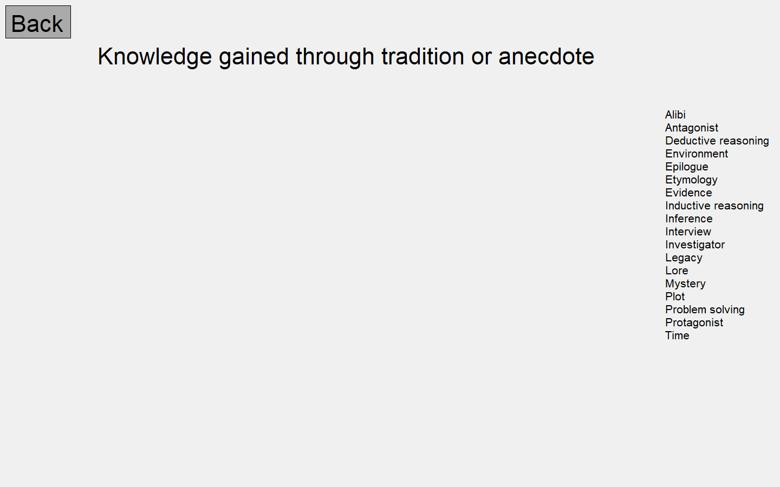
As you type, the words will be automatically capitalized and lowercased.
As you type, the first letter is automatically capitalized.

Slide 18
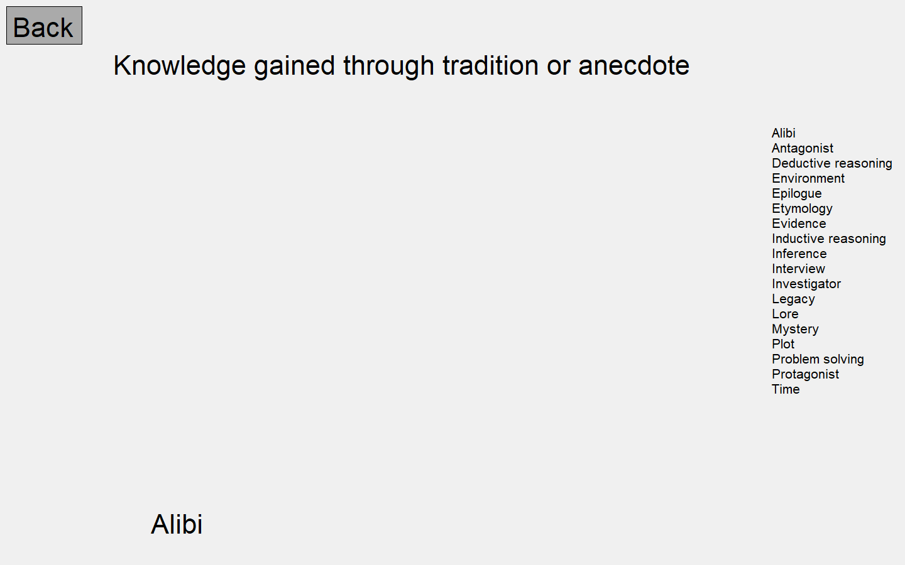

Slide 19
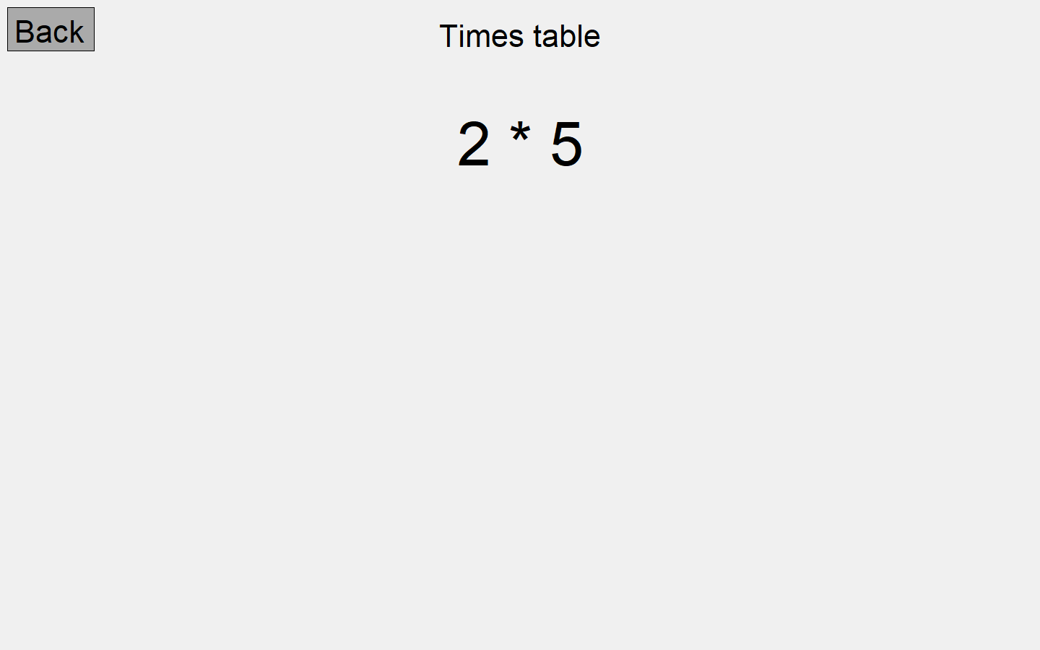

Slide 20
Feedback
We’ve tested with some people in our class. Some feedback are:
Alex – you guys should make a score and a timer.
Jhihyang – add timer. It’s good overall.
I think we could have added some aspects that would have made the game more fun, but overall I think that we have done a successful job on our project.

